Slide 1
Hamming Distance and Minimum Hamming Distance

Slide 2
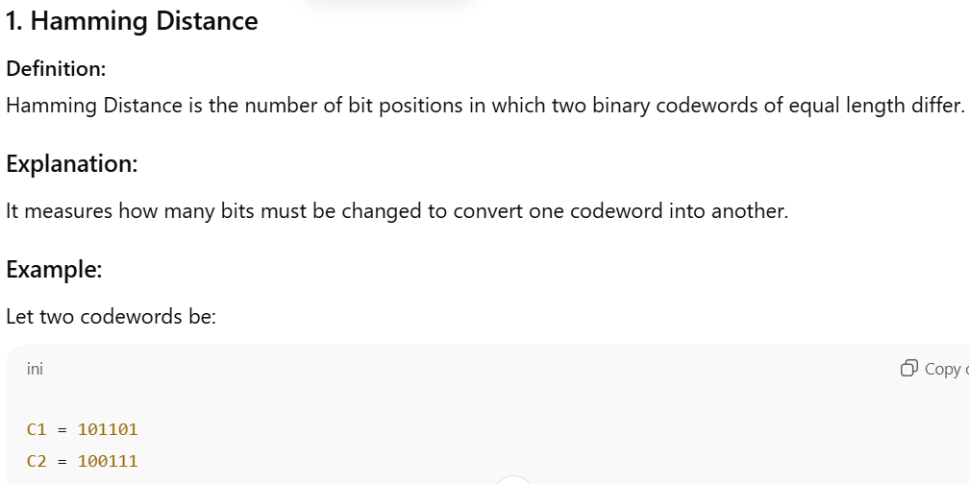

Slide 3
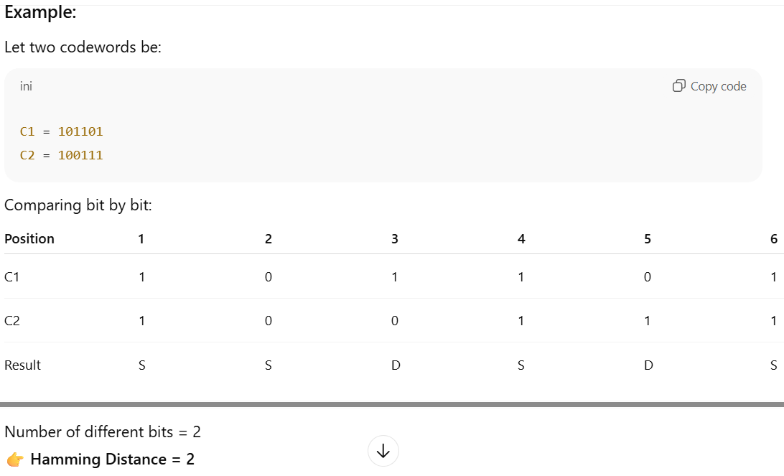

Slide 4
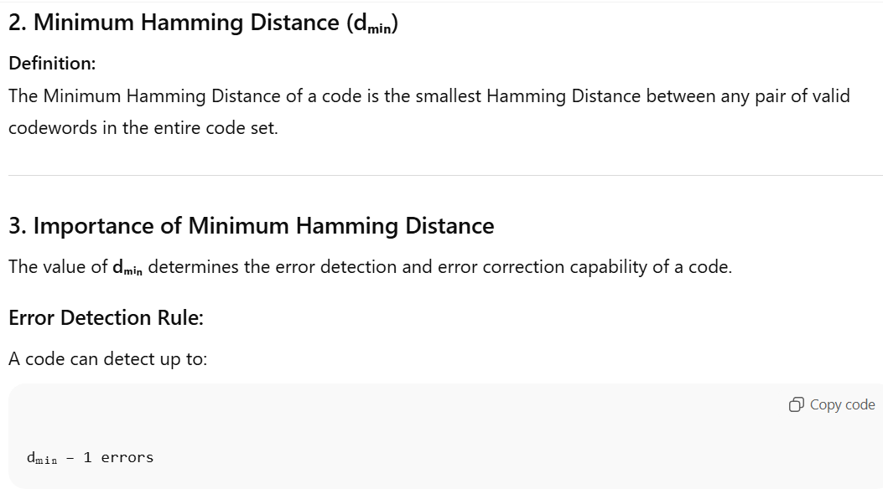

Slide 5
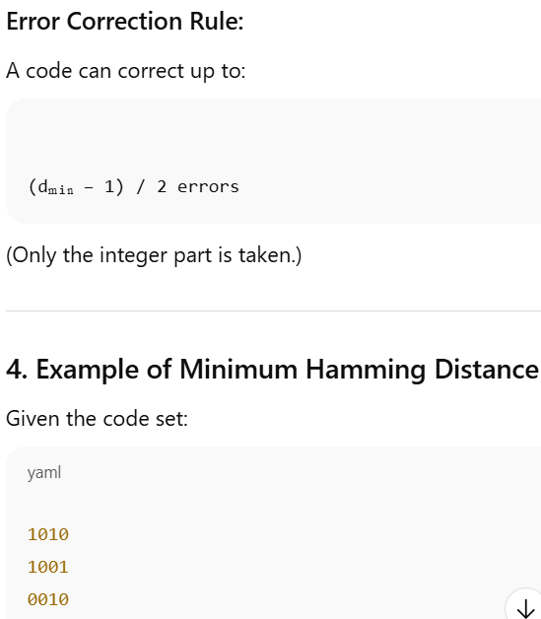
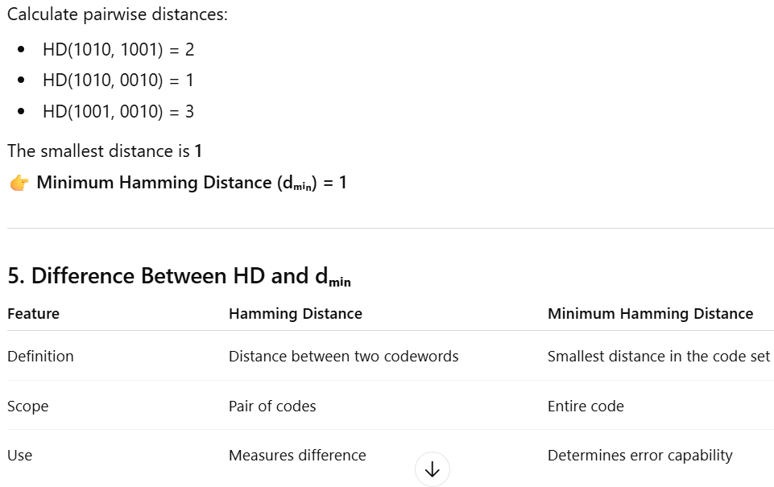

Slide 6

Hamming Code (With Example)

Slide 7
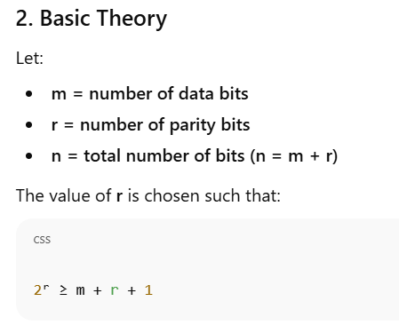
Hamming Code (With Example)

Slide 8
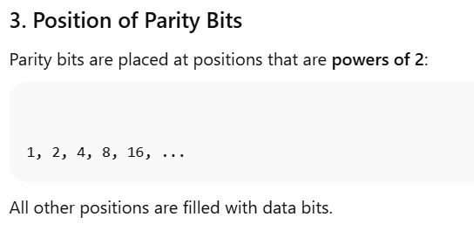
Hamming Code (With Example)

Slide 9
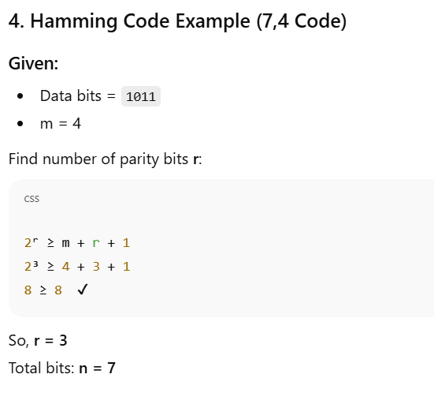
Hamming Code (With Example)

Slide 10

Hamming Code (With Example)

Slide 11
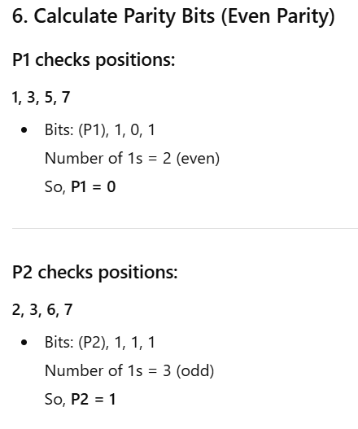
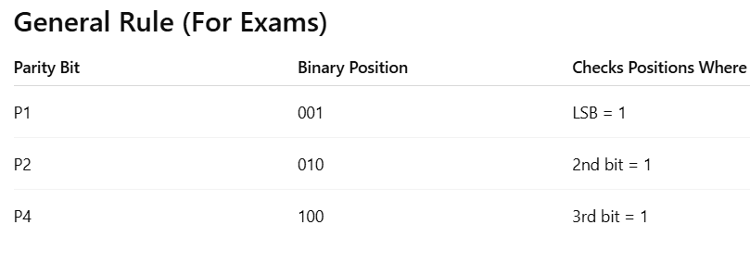
Hamming Code (With Example)

Slide 12

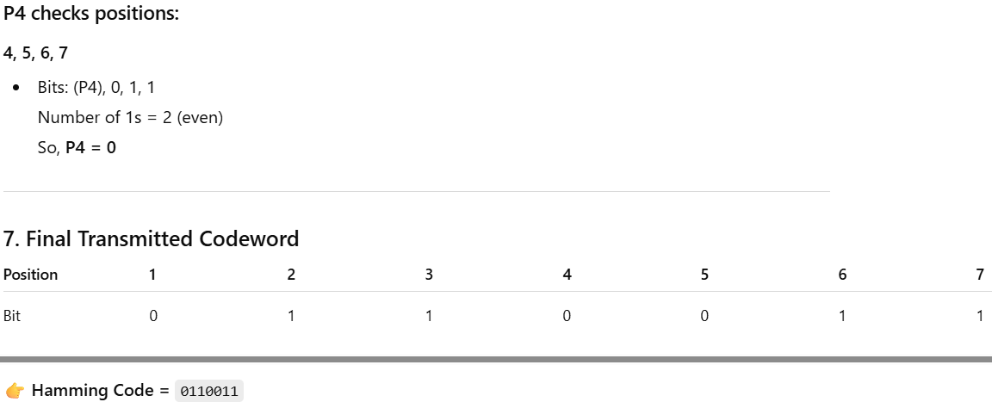
Hamming Code (With Example)

Slide 13
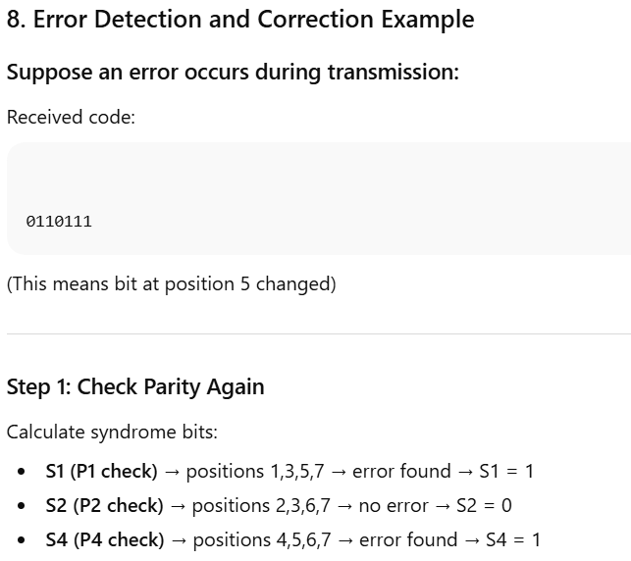
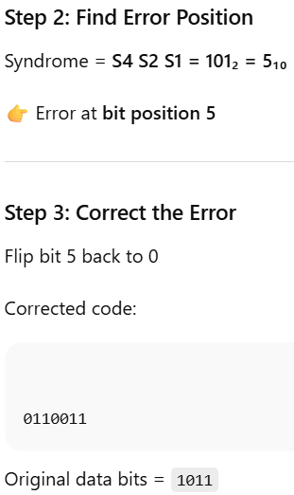
Hamming Code (With Example)

Slide 14
Hamming Code (With Example)

Slide 15
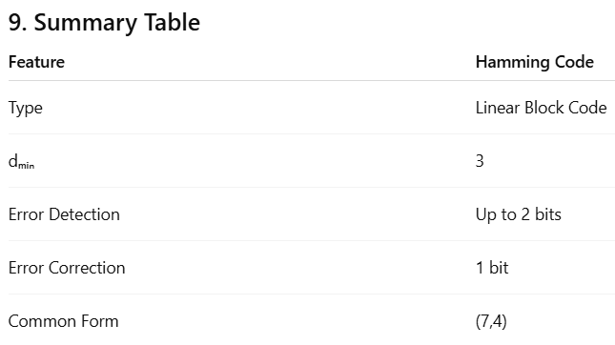
Hamming Code (With Example)

